Slide 1




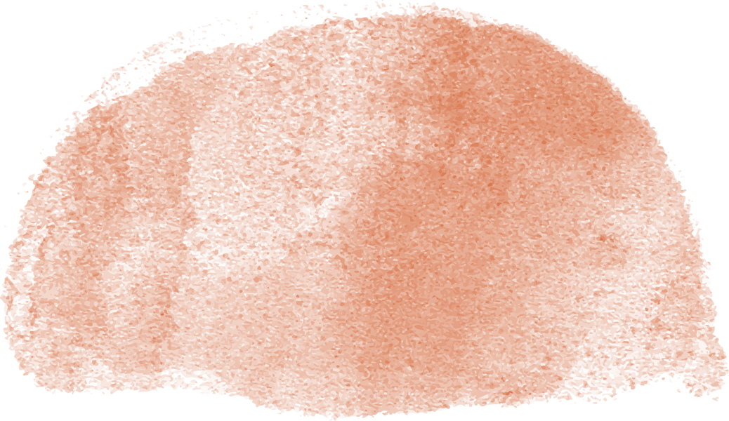
Faculty of Media Engineering and Technology
Using Facial Emotion Recognition (FER) and Speech Emotion Recognition (SER) to Detect Deepfake Videos
Zeina Hazem Hezzah
Bachelor Thesis | Spring 2024
Supervised By: Dr. Mervat Abuelkheir
Eng. Nada Ibrahim

Slide 2
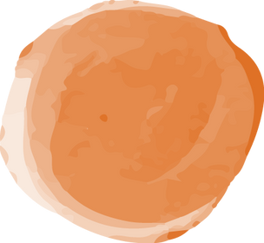

Agenda
01
02
03
Introduction
Objectives
Background & Related Work
04
05
06
Methodology
Results & Analysis
Conclusion & Future Work
1

Slide 3



01
Introduction

Slide 4


Hong Kong Deepfake Scam
In February 2024, a finance worker at the Hong Kong office of a major multinational firm was scammed out of $25.6 million.
Scammers initiated a conference call with deepfakes of all his coworkers.
The deepfake “CFO” instructed him to transfer the money to an offshore account.
the deepfakes ”looked and sounded just like colleagues he recognized”
Company loses $25 million dollars to deepfake video call scam (Casey Tonkin, 2024)
2

Slide 5



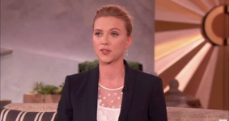
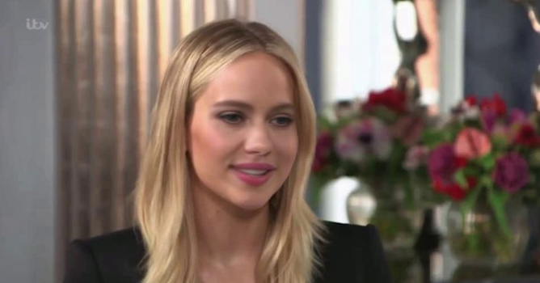
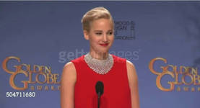

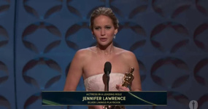

How are deepfakes generated?
A deep learning model is fed thousands of images and videos of people’s faces and learns how to mimic facial features and movements
Deep Learning Model
3

Slide 6
Detecting Deepfake Videos
Can the same deep learning techniques used to generate deepfake videos be used to detect them?
Deep Learning Model
Real
Fake
4

Slide 7

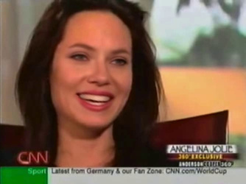
Detecting Deepfake Videos
Can the same deep learning techniques used to generate deepfake videos be used to detect them?
Are deepfakes capable of replicating all emotions accurately?
Deep Learning Model
Real
disgust?
sadness?
Fake
happiness?
5

Slide 8
02
Objectives

Slide 9
This thesis aims to:
Develop a deep learning model capable of distinguishing between authentic and deepfake videos.
1
Exploit previously developed emotion recognition models to identify emotions exhibited by the subjects in real and deepfake videos.
2
Assess the ability of deepfake generation techniques to accurately replicate human emotions
3
Observe the model’s ability to detect deepfake videos exhibiting different major emotions
4
6

Slide 10
03
Background

Slide 11
Emotion Recognition
7

Slide 12

Emotion Recognition
Categorical
Dimensional
6 DISTINCT classes of emotion
2 dimensions of emotional space
7

Slide 13

Emotion Recognition
Categorical
Dimensional
6 DISTINCT classes of emotion
2 dimensions of emotional space
anger
surprise
disgust
fear
sadness
valence
arousal
happiness
7

Slide 14
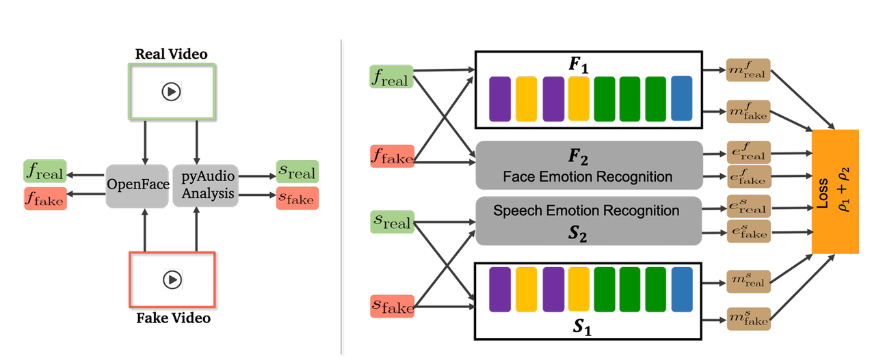
Categorical Detection Approach (Mittal et al.)
Approach:
Siamese network architecture with CNN and LSTM layers.
Similarity scores computed between the perceived emotion embeddings for both modalities.
Performance:
AUC of 84.4% on DFDC dataset.
AUC of 96.6% on DeepFake-TIMIT dataset.
Proposed training routine for categorical detection model (Mittal et al., 2020)
8

Slide 15
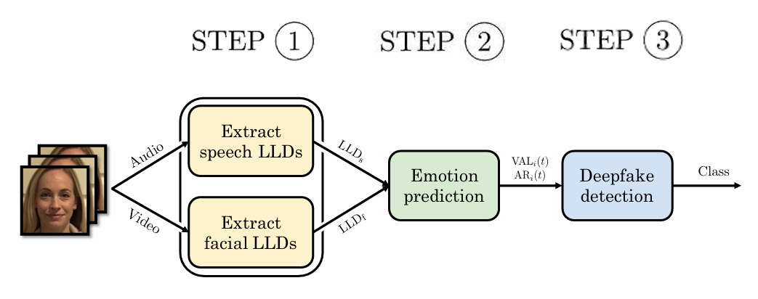
Dimensional Detection Approach (Hosler et al.)
Approach:
Extracted LLDs with OpenFace and OpenSmile.
LSTM-based network for valence and arousal time series.
Performance:
Higher accuracy for speech features (85%) than facial features (51.8%).
LSTM-based approach achieved 99.5% accuracy.
Proposed dimensional detection pipeline (Hosler et al., 2021)
9

Slide 16
04
Methodology

Slide 17




Methodology
Data Collection
Data Pre-Processing
Description of the datasets used to train and evaluate the model
Preparing data for model training and testing
Emotion Recognition
Model Development
Extracting emotion labels from videos
Breakdown of model architecture and components
10

Slide 18

Data
Collection

Slide 19
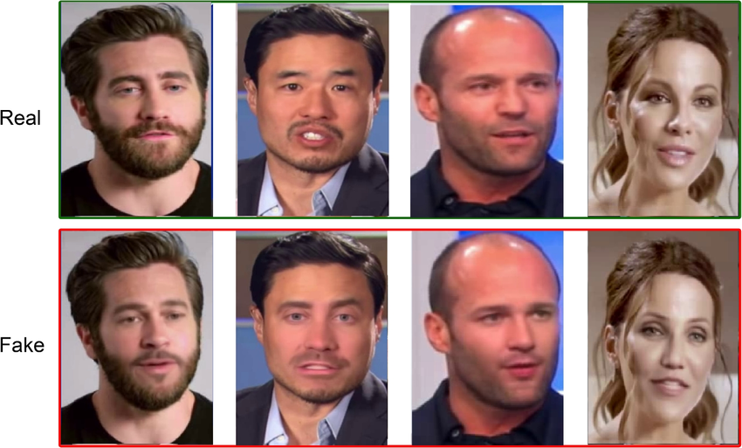
Celeb-DF
A comprehensive collection of videos assembled to focus on detecting deepfake videos involving the manipulation of celebrities’ faces
Examples videos from the Celeb-DF dataset (Megahed et al., 2023)
11

Slide 20
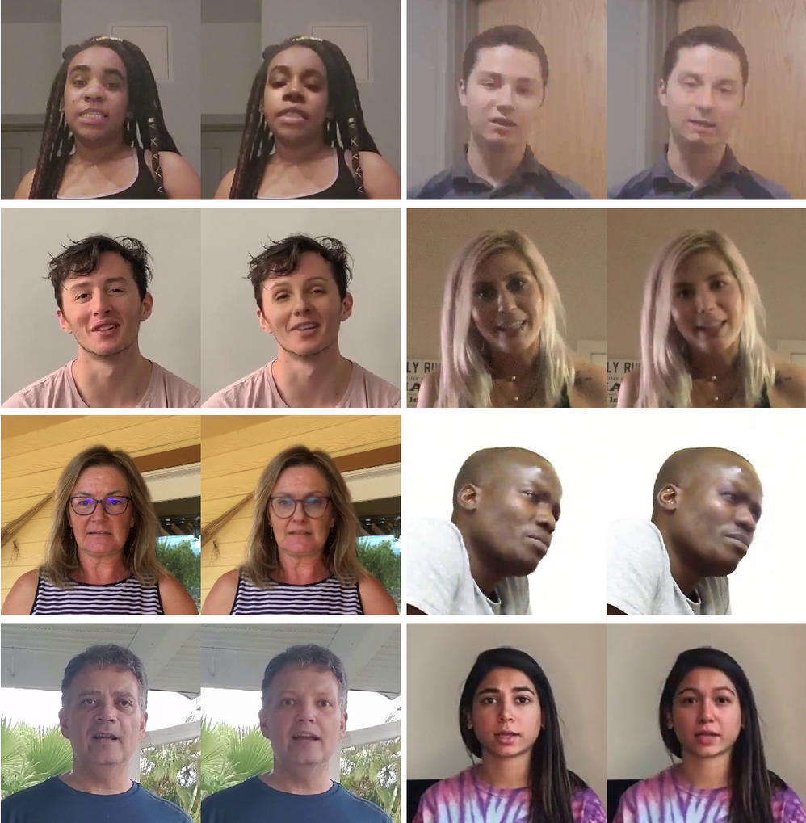
DeepFake Detection Challenge (DFDC)
Initiative launched by Meta, aimed at encouraging research and development in the detection of deepfake videos.
Examples videos from the DFDC dataset (Pflaum et al., 2019)
12

Slide 21
Emotion Recognition

Slide 22
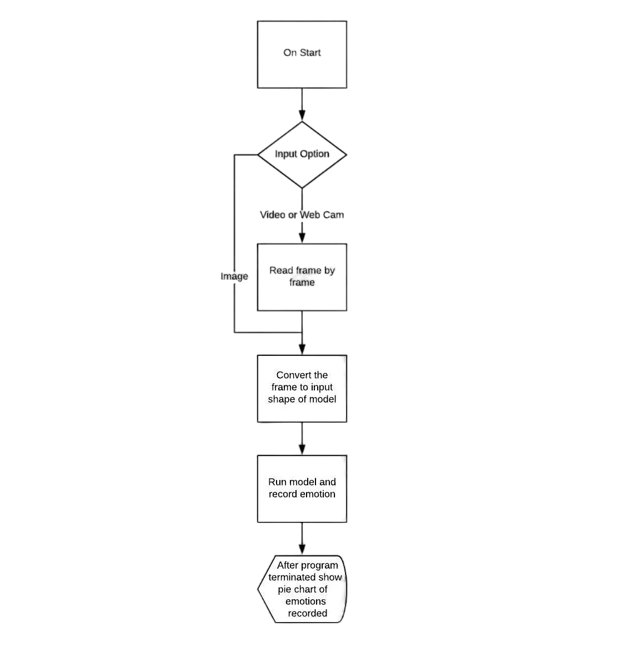
Facial Emotion Recognition Model
Pre-trained FER model by Madhur Chhajed
Modified CNN architecture
Trained on the Extended Cohn-Kanade (CK+) dataset
7 emotion classes (anger, contempt, disgust, fear, happiness, sadness, surprise)
Testing Accuracy = 98%
Works on live video stream or video file
13
FER System (Chhajed, 2020)

Slide 23
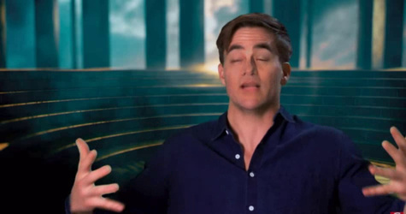



Emotion Extraction
OpenCV Video Capture
14

Slide 24

Emotion Extraction
Haar Cascade Classifier
[[[[0.09411765 0.09411765 0.09411765]
[0.09411765 0.09411765 0.09411765]
[0.10196079 0.10196079 0.10196079
[0.07058824 0.07058824 0.07058824]
[0.07450981 0.07450981 0.07450981]
[0.07450981 0.07450981 0.07450981]]
[[0.07450981 0.07450981 0.07450981]
[0.07450981 0.07450981 0.07450981]
[0.07843138 0.07843138 0.07843138]
[0.07450981 0.07450981 0.07450981]
[0.07843138 0.07843138 0.07843138]
[0.07843138 0.07843138 0.07843138]]]]
Frame
48 x 48
Encoded Frame
15

Slide 25

Emotion Extraction
FER Model
[[[[0.09411765 0.09411765 0.09411765]
[0.09411765 0.09411765 0.09411765]
[0.10196079 0.10196079 0.10196079
[0.07058824 0.07058824 0.07058824]
[0.07450981 0.07450981 0.07450981]
[0.07450981 0.07450981 0.07450981]]
[[0.07450981 0.07450981 0.07450981]
[0.07450981 0.07450981 0.07450981]
[0.07843138 0.07843138 0.07843138]
[0.07450981 0.07450981 0.07450981]
[0.07843138 0.07843138 0.07843138]
[0.07843138 0.07843138 0.07843138]]]]
[0.0029, 0.0011, 0.1867, 0.0009, 0.0316, 0.7467]
anger
fear
sadness
disgust
happiness
surprise
Encoded Frame
16

Slide 26
Emotion Extraction
FER Model
[[[[0.09411765 0.09411765 0.09411765]
[0.09411765 0.09411765 0.09411765]
[0.10196079 0.10196079 0.10196079
[0.07058824 0.07058824 0.07058824]
[0.07450981 0.07450981 0.07450981]
[0.07450981 0.07450981 0.07450981]]
[[0.07450981 0.07450981 0.07450981]
[0.07450981 0.07450981 0.07450981]
[0.07843138 0.07843138 0.07843138]
[0.07450981 0.07450981 0.07450981]
[0.07843138 0.07843138 0.07843138]
[0.07843138 0.07843138 0.07843138]]]]
[0.0029, 0.0011, 0.1867, 0.0009, 0.0316, 0.7467]
anger
fear
sadness
disgust
happiness
surprise
Encoded Frame
16

Slide 27
Data
Pre-Processing

Slide 28
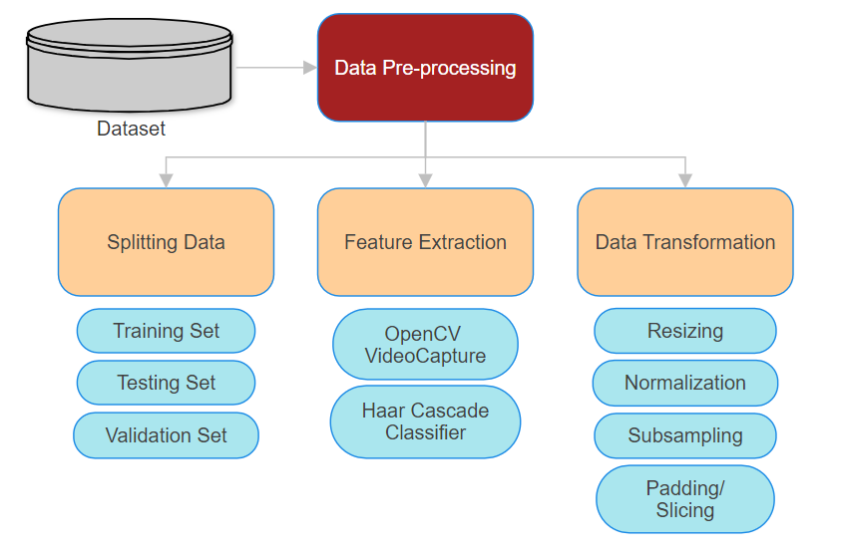
Data Pre-Processing Flow
17

Slide 29
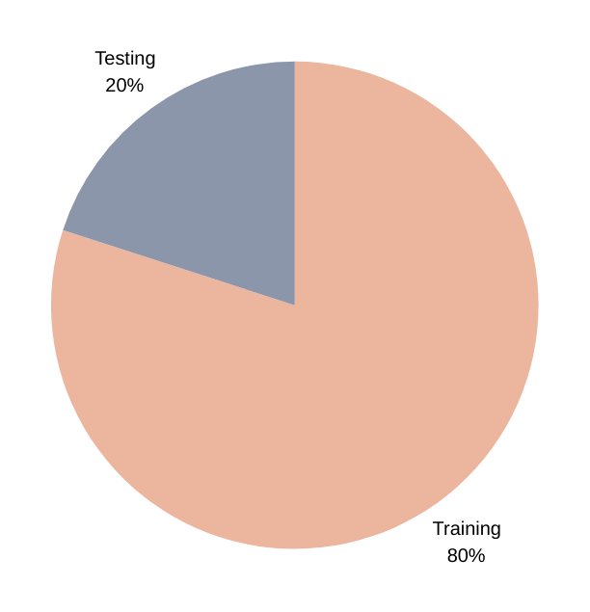

Splitting Data
Each dataset is divided into training, testing, and validation subsets
Dataset
18

Slide 30
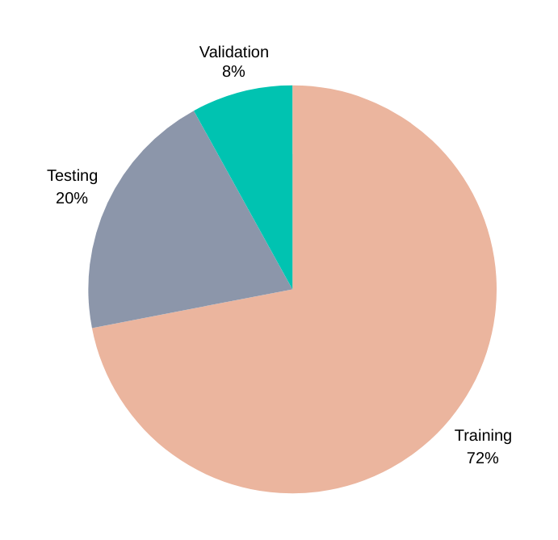
Splitting Data
Each dataset is divided into training, testing, and validation subsets
Dataset
18

Slide 31
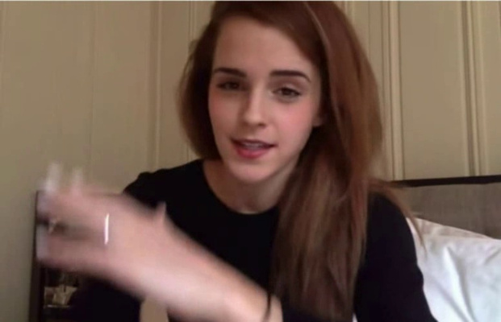
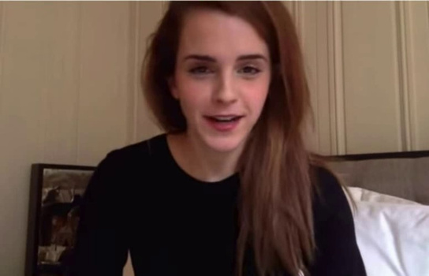
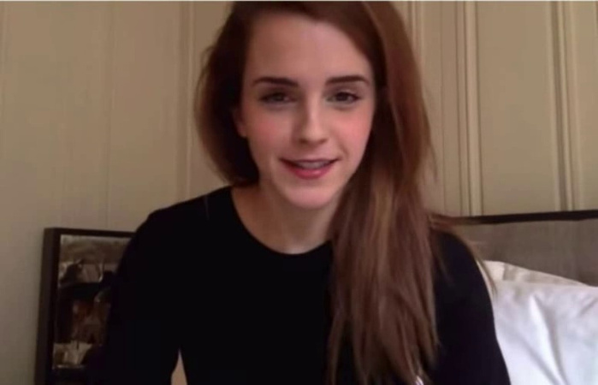
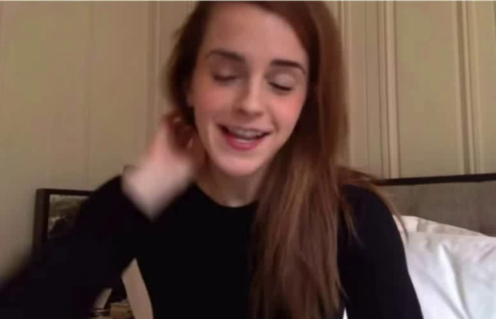
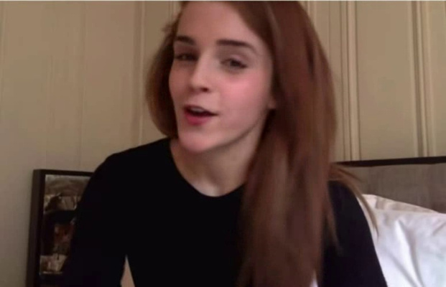
Feature Extraction
The frames are captured from each video and cropped around faces to focus on relevant data and eliminate any background noise.
OpenCV Video Capture
Haar Cascade Classifier
id11_0010.mp4
19

Slide 32
Data Transformation
02
01
Normalization
Resizing
The pixel values are normalized to a range between [0, 1] by dividing by 255.0.
Each frame is resized to a specified image size of 64×64
03
04
Subsampling
Padding/Slicing
Every 10th frame from the extracted frames for each video is selected
Each set of frames is adjusted to a sequence length of 50 frames
20

Slide 33
Model Development

Slide 34
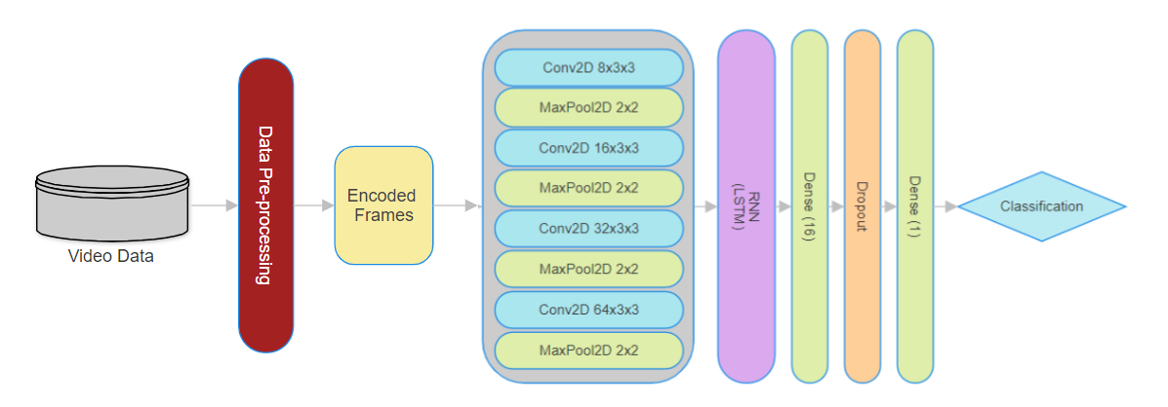
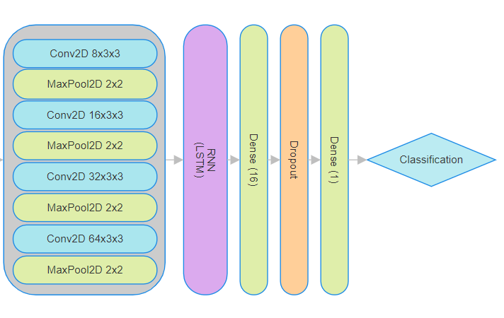

Model Architecture
+
CNN
RNN
Spatial Analysis
Temporal Analysis
features WITHIN each frame
discrepancies BETWEEN frames
21

Slide 35
Convolutional Neural Network (CNN) Component
Conv2D (8 x 3 x 3) - ReLU activation
MaxPooling (2 x 2)
Conv2D (16 x 3 x 3) - ReLU activation
MaxPooling (2 x 2)
Conv2D (32 x 3 x 3) - ReLU activation
MaxPooling (2 x 2)
Conv2D (64 x 3 x 3) - ReLU activation
MaxPooling (2 x 2)
22

Slide 36

Recurrent Neural Network (RNN) Component
32 Unit Long Short-Term Memory (LSTM) Layer
Input: spatial feature maps of consecutive frames produced by Time-Distributed CNN
Output: temporal evolution of feature maps across frames and long-term dependencies
Architecture of a Recurrent Neural Network (Olah, 2015)
23

Slide 37
Fully Connected Layer
16-Unit Dense Layer
Applies the ReLU activation function to the LSTM output to introduce non-linearity
Dropout Layer (0.2)
Sets a random 20% of the output data to zero to prevent overfitting
1-Unit Dense Layer
Performs binary classification by applying the Sigmoid activation function to map the output to a value between [0,1].
value < 0.5 REAL (0)
value > 0.5 DEEPFAKE (1)
24

Slide 38
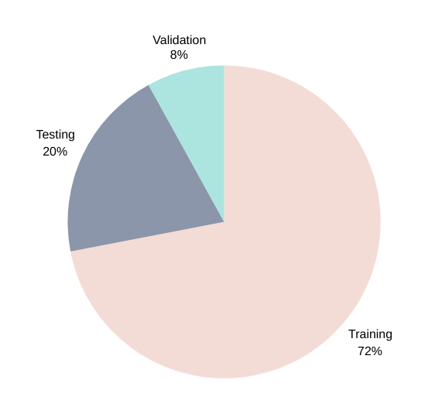
Testing Data
Video | Label | Major_Emotion
id10_id2_0002.mp4 | FAKE | fear
id3_0001.mp4 | REAL | happiness
id1_id20_0010.mp4 | FAKE | happiness
id4_id9_0003.mp4 | FAKE | anger
.... | .... | ....
25

Slide 39

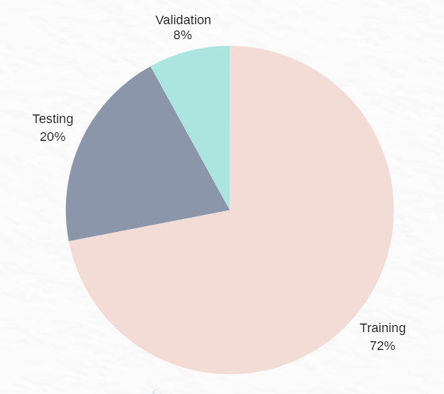

Testing Data
Video | Label | Major_Emotion
id10_id2_0002.mp4 | FAKE | fear
id3_0001.mp4 | REAL | happiness
id1_id20_0010.mp4 | FAKE | happiness
id4_id9_0003.mp4 | FAKE | anger
.... | .... | ....
Happiness Testing Set
25

Slide 40
Testing Data
Fear Testing Set
Video | Label | Major_Emotion
id10_id2_0002.mp4 | FAKE | fear
id3_0001.mp4 | REAL | happiness
id1_id20_0010.mp4 | FAKE | happiness
id4_id9_0003.mp4 | FAKE | anger
.... | .... | ....
Happiness Testing Set
25

Slide 41
Testing Data
Fear Testing Set
Video | Label | Major_Emotion
id10_id2_0002.mp4 | FAKE | fear
id3_0001.mp4 | REAL | happiness
id1_id20_0010.mp4 | FAKE | happiness
id4_id9_0003.mp4 | FAKE | anger
.... | .... | ....
Happiness Testing Set
Anger Testing Set
25

Slide 42

Training Setup
All training and testing was done through
The hyperparameters used for model training are
Hyperparameter | Value/Type
Number of Epochs | 15
Batch Size | 32
Learning Rate | 0.0001
Optimizer | ADAM
26

Slide 43
05
Results and Analysis

Slide 44
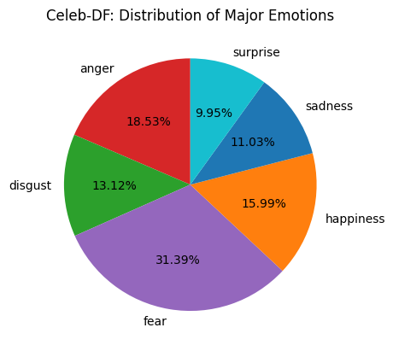
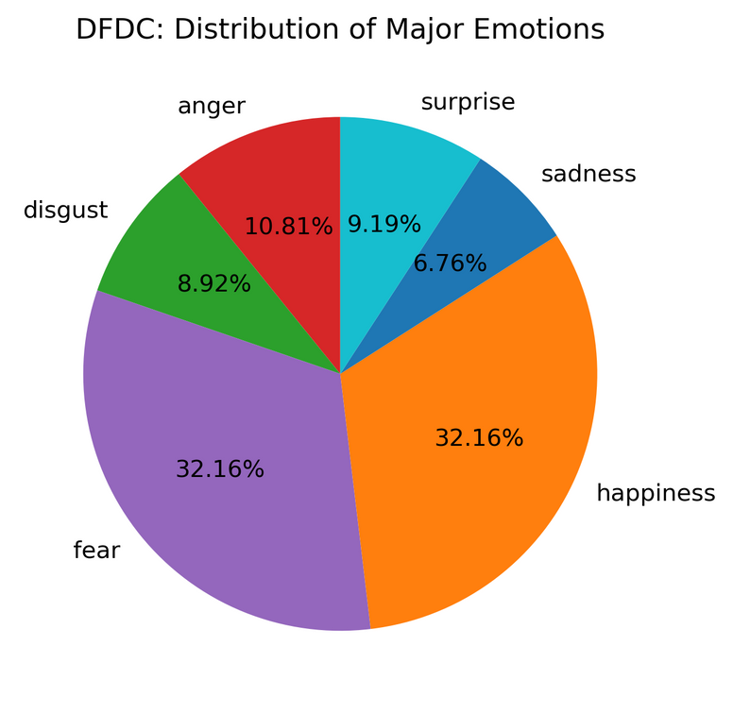
Emotion Distribution
An analysis of the prevalence of each detected emotion class in the videos of both datasets
Celeb-DF
DFDC
27

Slide 45
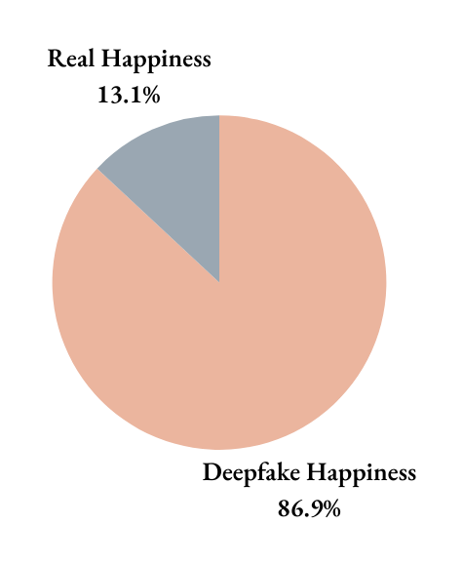
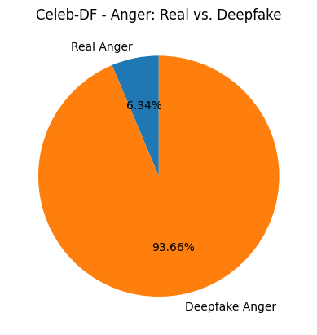
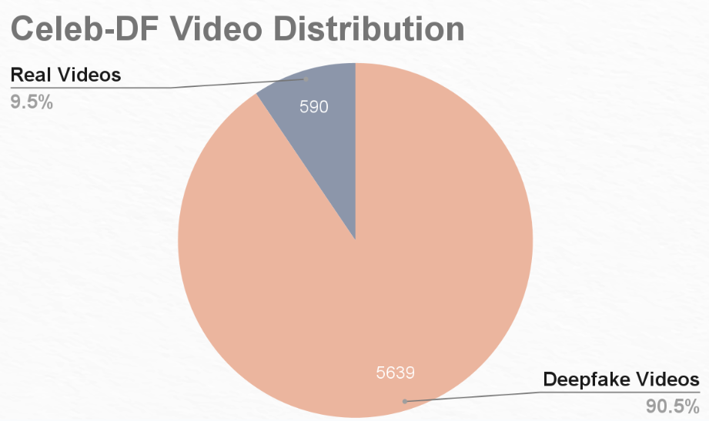
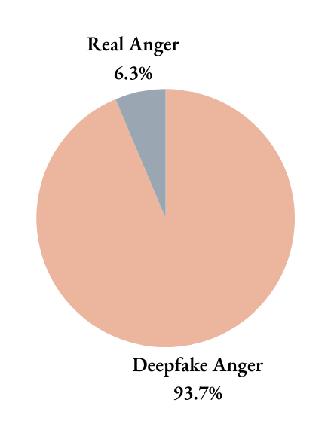
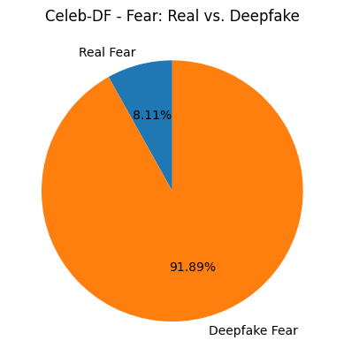
Emotion Distribution
Happiness
Anger
28

Slide 46
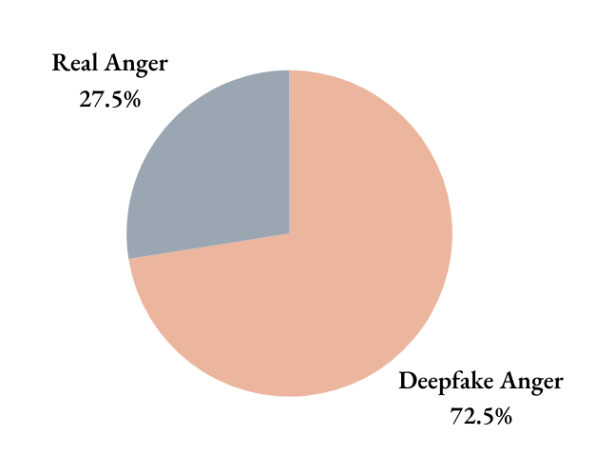
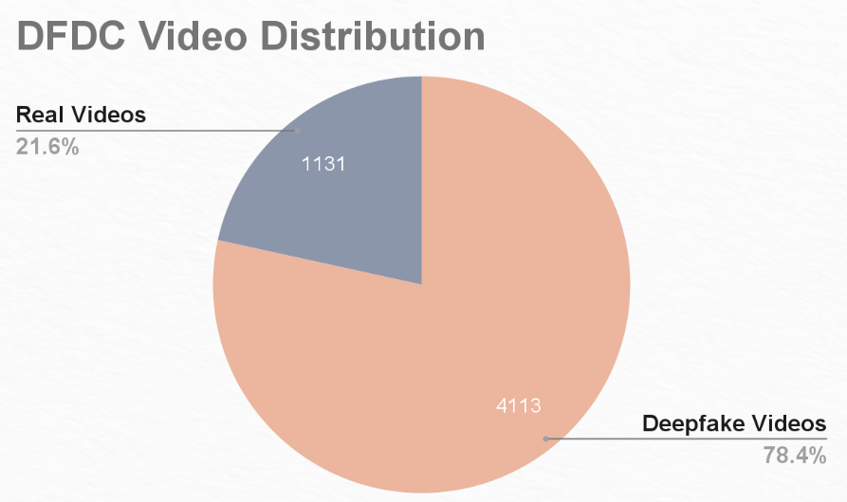
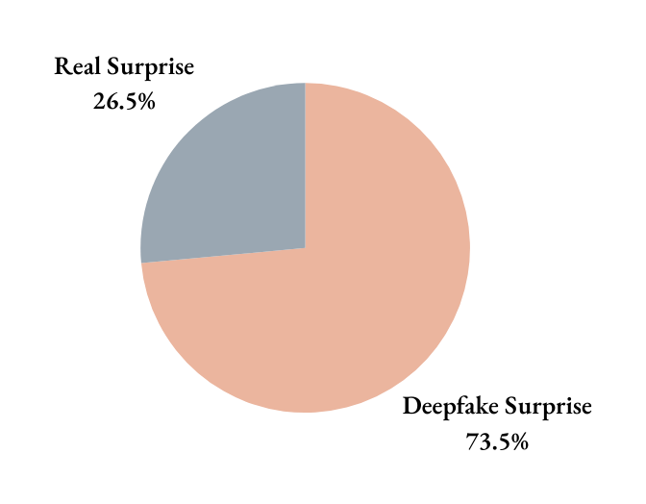
Emotion Distribution
Anger
Surprise
29

Slide 47
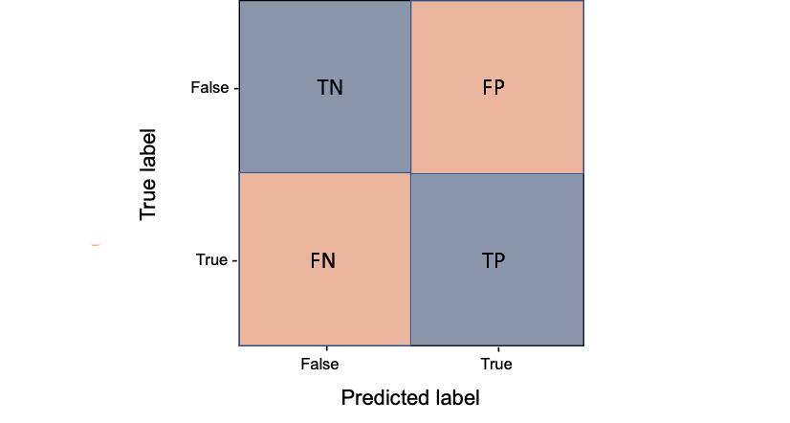
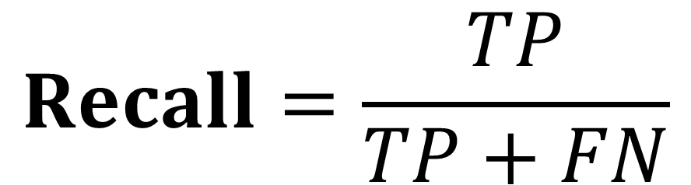
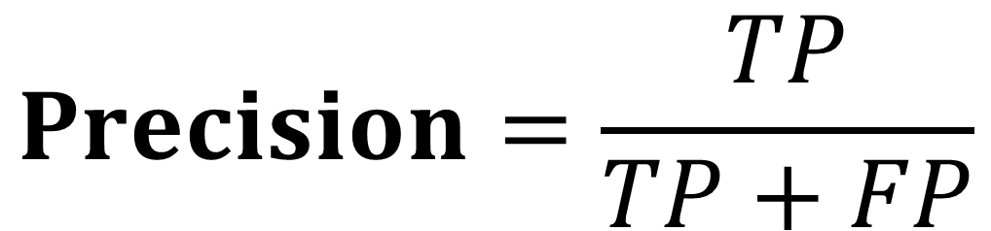
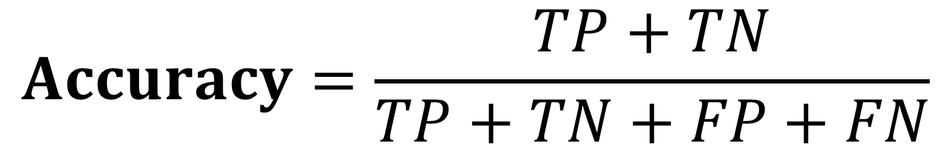
Testing Metrics
$$Accuracy=\frac{TP+TN}{TP+TN+FP+FN}$$
$$Precision=\frac{TP}{TP+FP}$$
$$Recall=\frac{TP}{TP+FN}$$
30

Slide 48
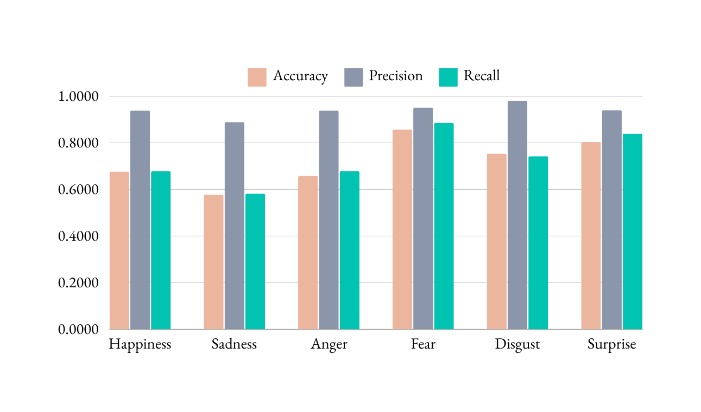
Testing Performance
For each dataset the model was tested on each emotion class and the following metrics were observed
Celeb-DF
31

Slide 49
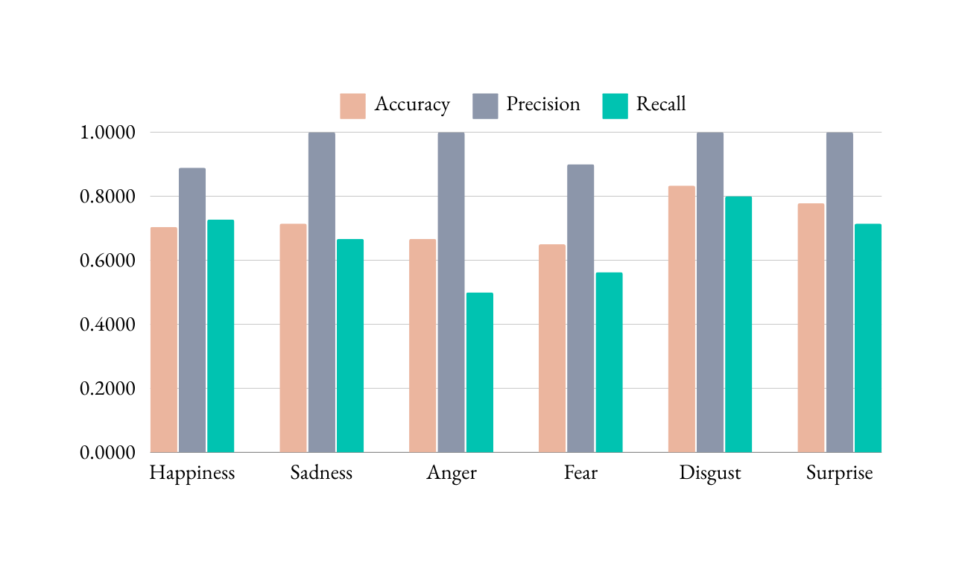
Testing Performance
For each dataset the model was tested on each emotion class and the following metrics were observed
DFDC
32

Slide 50
Testing Performance
The table below shows the maximum accuracy achieved for each emotion class on both datasets
 | Celeb-DF | DFDC
Happiness | 67.65% | 70.37%
Sadness | 57.73% | 71.43%
Anger | 65.83% | 66.67%
Fear | 85.71% | 65.00%
Disgust | 75.34% | 83.33%
Surprise | 80.32% | 77.78%
33

Slide 51






Limitations
Limited Datasets
Unbalanced Datasets
Low Quality
No Audio
Hardware Limitations
34

Slide 52
06
Conclusion & Future Work

Slide 53
Key Findings
Variable distribution of real and deepfake videos across emotions highlights the complexity of accurately replication human emotions
Model accuracy varies across different emotions, indicating that emotional cues affect deepfake detection.
Subtler emotions like sadness and happiness are more difficult to detect.
Expressive emotions with complex features like disgust and surprise are detected more accurately.
35

Slide 54



Future Work
Datasets
Multi-Modality
Assembling more balanced, representative datasets with better quality videos.
Integrating emotion recognition of different modalities such as speech and text
Model Refinement
Fine-tuning the model and adjusting it to improve detecting accuracy
36

Slide 55

References
Heather Chen and Kathleen Magramo. Finance worker pays out $25 million after video call with deepfake “chief financial officer”, Feb 2024.
Trisha Mittal, Uttaran Bhattacharya, Rohan Chandra, Aniket Bera, and Dinesh Manocha. Emotions don’t lie: An audio-visual deepfake detection method using affective cues. In Proceedings of the 28th ACM International Conference on Multimedia, MM’20, page 2823–2832, New York, NY, USA, 2020. Association for Computing Machinery.
Brian Hosler, Davide Salvi, Anthony Murray, Fabio Antonacci, Paolo Bestagini, Stefano Tubaro, and Matthew C. Stamm. Do deepfakes feel emotions? a semantic approach to detecting deepfakes via emotional inconsistencies. In Proceedings of the IEEE/CVF Conference on Computer Vision and Pattern Recognition (CVPR) Workshops, pages 1013–1022, June 2021
Amr Megahed, Qi Han, and Sondos Fadl. Exposing deepfake using fusion of deep-learned and hand-crafted features. Multimedia Tools and Applications, 83:1–21, 09 2023.
Ben Pflaum, Nicole Baram, Cristian Canton Ferrer, Brian Dolhansky, Russ Howes. The Deepfake Detection Challenge (DFDC) preview dataset, 2019.
Madhur Chhajed. Feedback system using facial emotion recognition, Dec 2020
Christopher Olah. Understanding LSTM networks, Aug 2015
37

Slide 56
Any Questions?

Slide 57
Thank You!
Presented By: Zeina Hezzah

Slide 58
Supplementary Slides

Slide 59
What are deepfakes?
using Deep Learning to create Fake media
Deep
Fake
hyper-realistic synthetic media that have been digitally manipulated to depict people saying and doing things that never actually happened through facial or speech manipulation.
38

Slide 60
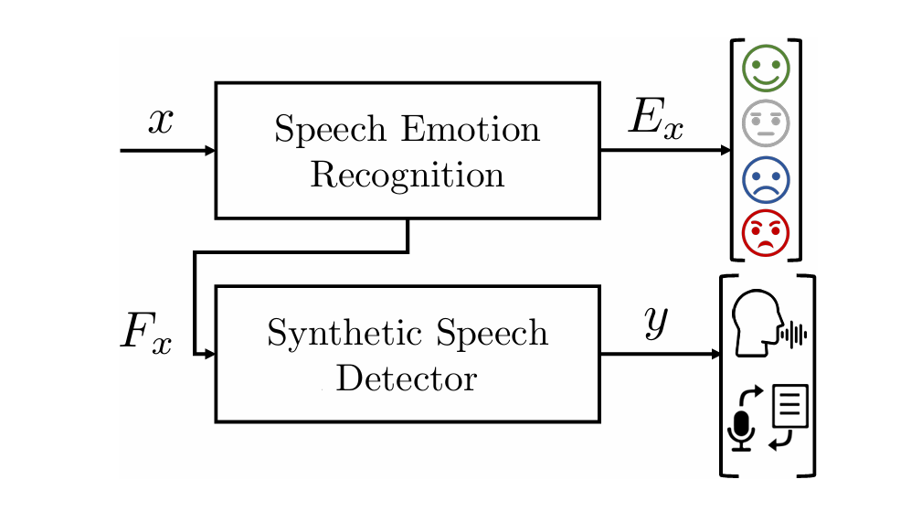
Audio-Based Detection (Conti et al.)
Approach:
Transfer-learning model combining Speech Emotion Recognition (SER) and Synthetic Speech Detector (SSD).
Extracted log-mel spectrogram features, processed with 3D CNN, BLSTM, and dense layers.
Performance:
Achieved AUC of 0.98 on multiple datasets.
Robust to audio noise augmentation.
proposed system architecture (Contu et al.)
39

Slide 61
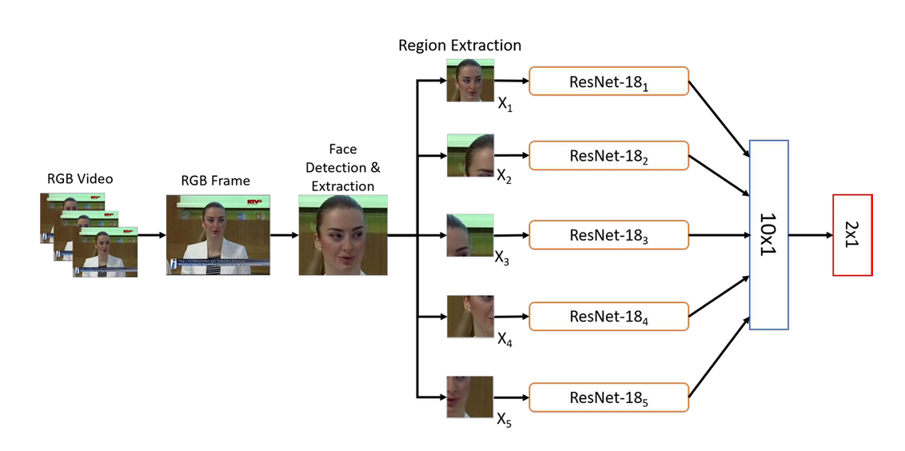
Visual-Based Detection (Kumar et al.)
Approach:
Multi-stream network with five ResNet-18 models.
Cropped facial regions used as input.
Performance:
Mean classification accuracy of 90.40% on FaceForensics dataset.
Left-sided features and eye region provided better accuracy.
proposed system architecture (Kumar et al.)
40

Slide 62
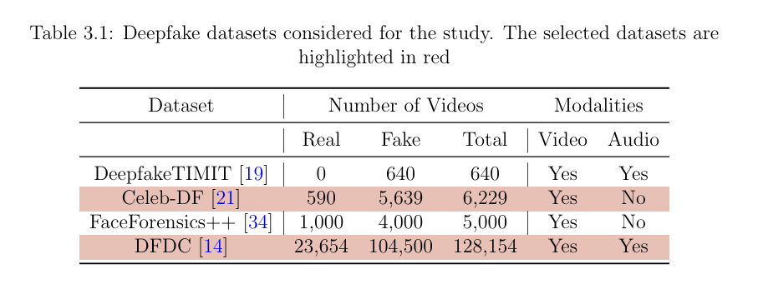
Datasets
*
* Poor quality audio with a lot of noise
41

Slide 63
Emotion Extraction
We define a dictionary to map the output indices of the FER model predictions to their corresponding emotion labels
Model Output | Predicted Emotion Label
0 | anger
2 | disgust
3 | fear
4 | happiness
5 | sadness
6 | surprise
42

Slide 64



Generating Labels
DFDC
Celeb-DF
Celeb-real
Celeb-synthesis
metadata.json
Video | Label | Major_Emotion
.... | .... | ....
id16_id0_0004.mp4
FAKE
fear
id2_0008.mp4
REAL
happiness
43

Slide 65
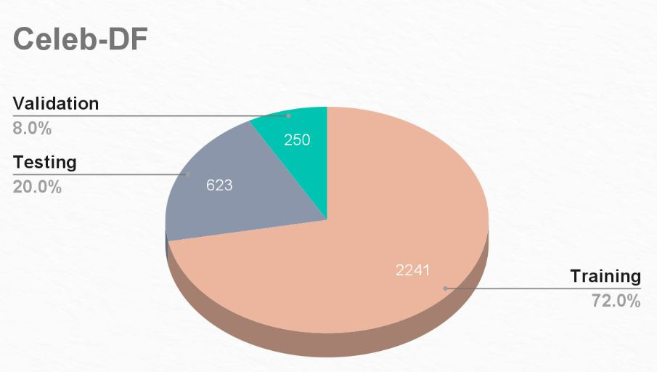
Subset | Real | Fake
Training | 212 | 2029
Testing | 59 | 564
Validation | 24 | 226
44

Slide 66
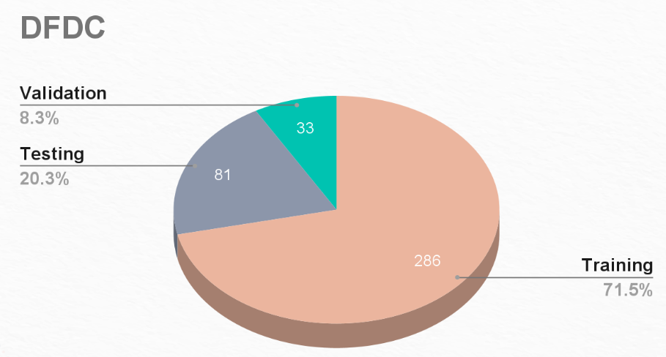
Subset | Real | Fake
Training | 54 | 232
Testing | 16 | 65
Validation | 7 | 26
45

Slide 67
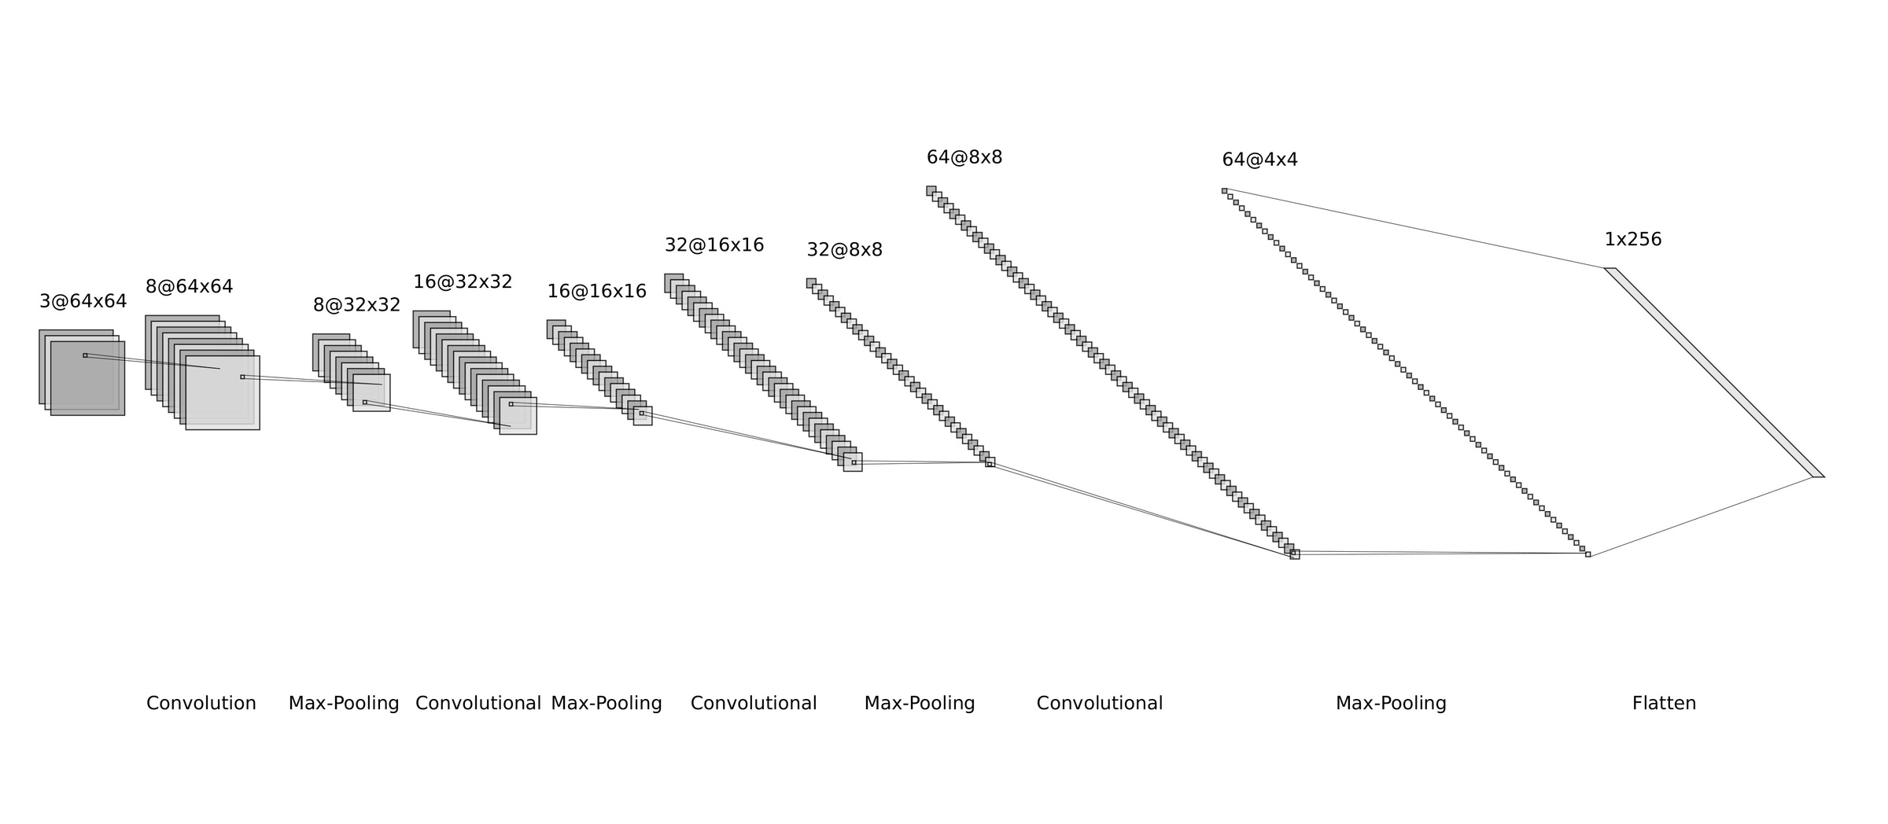
Convolutional Neural Network (CNN) Component
46

Slide 68
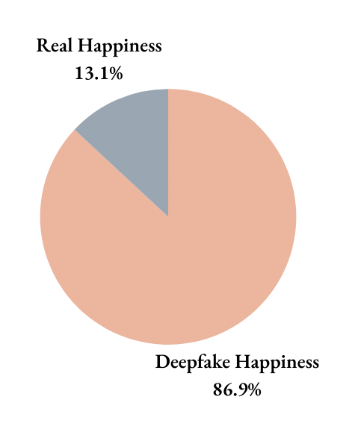
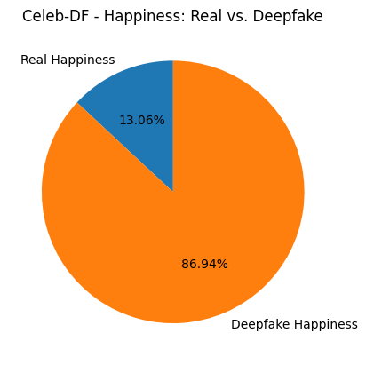
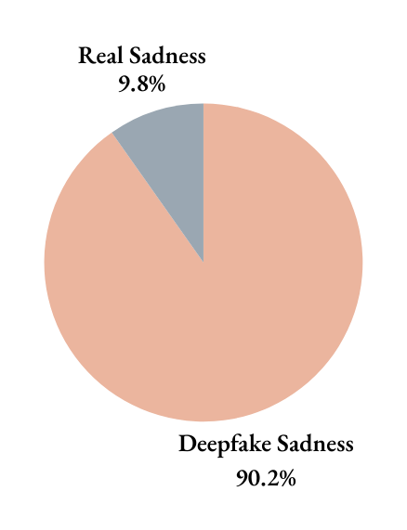

Emotion Distribution
1
Happiness
2
Sadness
47

Slide 69


Emotion Distribution
3
Anger
4
Fear
48

Slide 70


Emotion Distribution
5
Disgust
6
Surprise
49

Slide 71


Emotion Distribution
1
Happiness
2
Sadness
50

Slide 72


Emotion Distribution
3
Anger
4
Fear
51

Slide 73


Emotion Distribution
5
Disgust
6
Surprise
52

Slide 74


Training Performance
Evolution of accuracy and loss over multiple epochs to illustrate how the model’s performance evolved during training and validation
Celeb-DF
53

Slide 75


Training Performance
Evolution of accuracy and loss over multiple epochs to illustrate how the model’s performance evolved during training and validation
DFDC
54

Slide 76


Testing Performance
For each dataset the model was tested on each emotion class and the following metrics were observed
Celeb-DF
1
2
Happiness
Sadness
Metric | Value
Accuracy | 0.6765
Loss | 0.4872
Precision | 0.9385
Recall | 0.6777
Metric | Value
Accuracy | 0.5773
Loss | 0.4912
Precision | 0.8888
Recall | 0.5818
55

Slide 77


Testing Performance
For each dataset the model was tested on each emotion class and the following metrics were observed
Celeb-DF
3
4
Anger
Fear
Metric | Value
Accuracy | 0.6583
Loss | 0.4901
Precision | 0.9382
Recall | 0.6785
Metric | Value
Accuracy | 0.8571
Loss | 0.3487
Precision | 0.9509
Recall | 0.8857
56

Slide 78


Testing Performance
For each dataset the model was tested on each emotion class and the following metrics were observed
Celeb-DF
5
6
Disgust
Surprise
Metric | Value
Accuracy | 0.7534
Loss | 0.3921
Precision | 0.9800
Recall | 0.7424
Metric | Value
Accuracy | 0.8032
Loss | 0.3702
Precision | 0.9400
Recall | 0.8392
57

Slide 79


Testing Performance
For each dataset the model was tested on each emotion class and the following metrics were observed
DFDC
1
2
Happiness
Sadness
Metric | Value
Accuracy | 0.7037
Loss | 0.1801
Precision | 0.8889
Recall | 0.7272
Metric | Value
Accuracy | 0.7143
Loss | 0.1582
Precision | 1.0000
Recall | 0.6667
58

Slide 80


Testing Performance
For each dataset the model was tested on each emotion class and the following metrics were observed
DFDC
3
4
Anger
Fear
Metric | Value
Accuracy | 0.6667
Loss | 0.2268
Precision | 1.0000
Recall | 0.5000
Metric | Value
Accuracy | 0.6500
Loss | 0.2390
Precision | 0.9000
Recall | 0.5625
59

Slide 81


Testing Performance
For each dataset the model was tested on each emotion class and the following metrics were observed
DFDC
5
6
Disgust
Surprise
Metric | Value
Accuracy | 0.8333
Loss | 0.1518
Precision | 1.0000
Recall | 0.8000
Metric | Value
Accuracy | 0.7778
Loss | 0.1768
Precision | 1.0000
Recall | 0.7143
60

